Slide 1
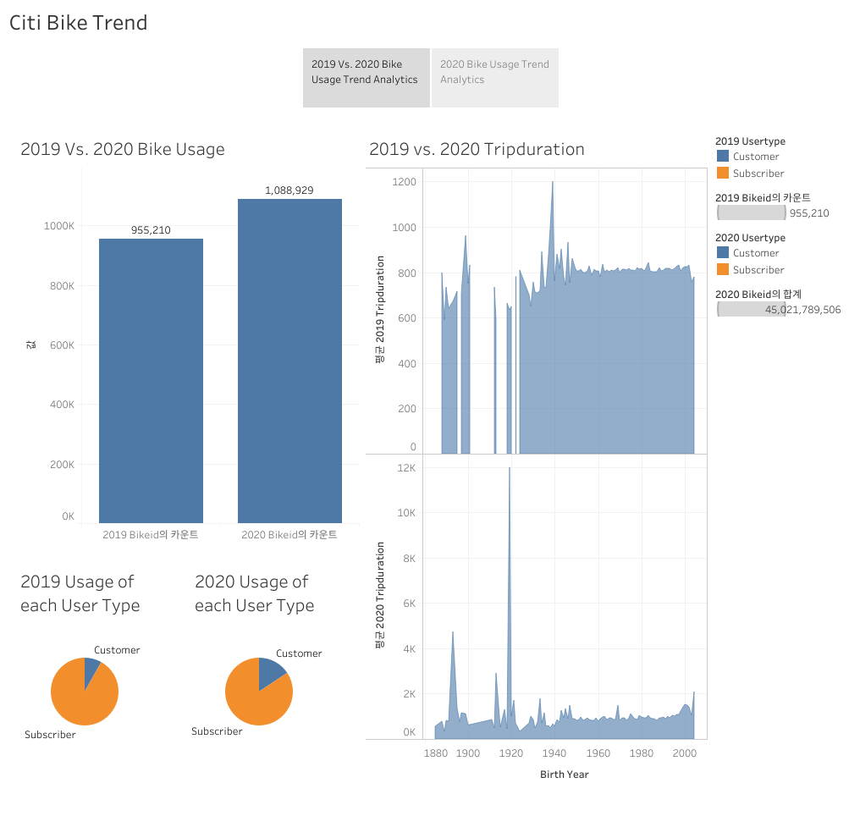
When I evaluate the 2019 Dec. and 2020 Dec. data set,
the Bike usage is increased in 2020.
Compared to 2019 Dec., the customer rate is increased in 2020.
It means that annual subscriber is decreased.
The birth year of 1920 has the highest trip duration average.
In 2019, it’s not that fluctuated compared to 2020 and
the trip duration average of each birth year is stabilized.

Slide 2
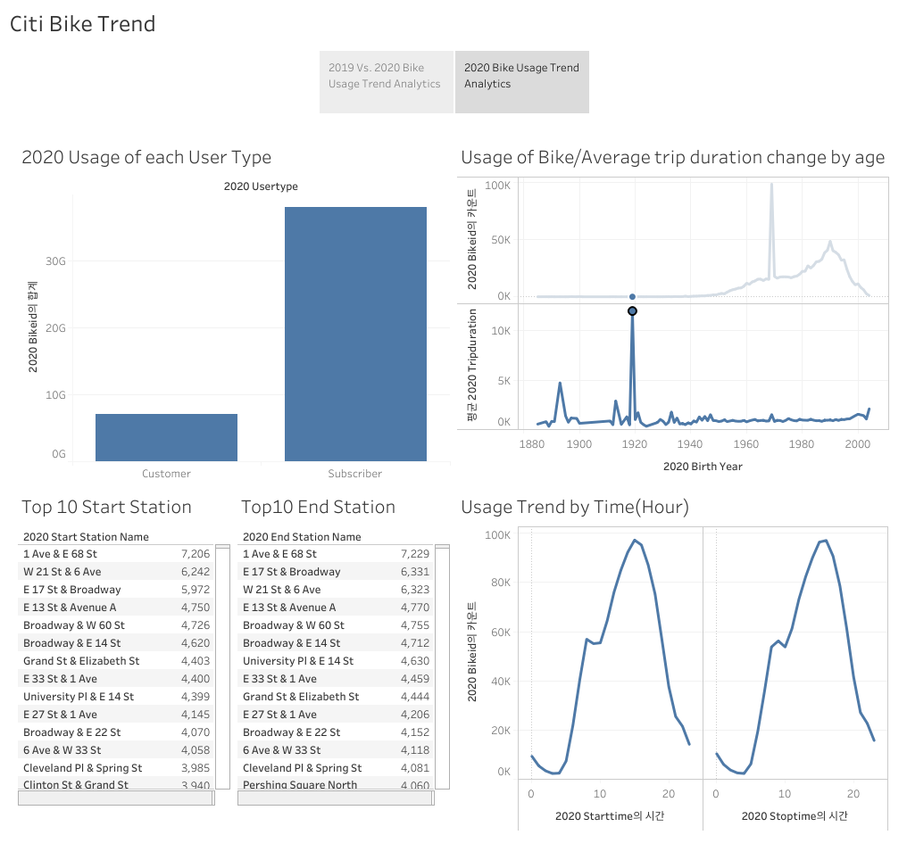
Through 2020 Dec. data set, subscribers which has annual pass have the highest number than customer which has 1~3days pass have.
I found that Top 10 start and end stations are very similar. It means that some locations have loyal subscribers for any reason.
There is the highest bike usage count with birth year 1963~4, but the trip duration average of 1920’s has the highest. It has no relevant between usage count of birth year and trip duration average of the year.
Usage start/stop time has almost same graph and
I found that it has peak time zone as 1pm-3pm.

